Slide 1

HAVE YOU EVER VISITED THE UAE?
DO YOU KNOW WHY ITS STREETS ARE SO CLEANNNN?
NO?!

Slide 2

OKAY THEN LET US INTRODUCE YOU

Slide 3


BEEAH operates in several industries, including waste management,
environmental consulting, and renewable energy. Its waste management services include collection,
transportation,treatment, and disposal of all types of waste, including
hazardous and nonhazardous waste. BEEAH is also involved in recycling,composting, and waste to energy projects
BEEAH (the Emirates Environmental Services Company) is a pioneer leading integrated environmental management company based in the United Arab Emirates (UAE). It was established in 2007 with the aim of providing sustainable waste management solutions and environmental services in the region.
.

Slide 4
BEEAH operates in several industries, including waste management,
environmental consulting, and renewable energy. Its waste management services include collection,
transportation,treatment, and disposal of all types of waste, including
hazardous and nonhazardous waste. BEEAH is also involved in recycling,composting, and waste to energy projects
BEEAH (the Emirates Environmental Services Company) is a pioneer leading integrated environmental management company based in the United Arab Emirates (UAE). It was established in 2007 with the aim of providing sustainable waste management solutions and environmental services in the region.
.

Slide 5

Crossing new industry frontiers every day,
BEEAH Group is inspiring positive change, enabling rapid economic growth, and consolidating the UAE’s position as a global model for sustainable development and digital innovations.
Having over 200 clients
Representing
46
nationalities
13000
employees
This project became possible by the aid of

Slide 6
Crossing new industry frontiers every day,
BEEAH Group is inspiring positive change, enabling rapid economic growth, and consolidating the UAE’s position as a global model for sustainable development and digital innovations.
Having over 200 clients
Representing
46
nationalities
This project became possible by the aid of
13000
employees

Slide 7
Crossing new industry frontiers every day,
BEEAH Group is inspiring positive change, enabling rapid economic growth, and consolidating the UAE’s position as a global model for sustainable development and digital innovations.
Having over 200 clients
This project became possible by the aid of
Representing
46
nationalities
13000
employees

Slide 8
Crossing new industry frontiers every day,
BEEAH Group is inspiring positive change, enabling rapid economic growth, and consolidating the UAE’s position as a global model for sustainable development and digital innovations.
This project became possible by the aid of
Representing
46
nationalities
Having over 200 clients
13000
employees

Slide 9
This project became possible by the aid of
Representing
46
nationalities
Having over 200 clients
13000
employees
Crossing new industry frontiers every day,
BEEAH Group is inspiring positive change, enabling rapid economic growth, and consolidating the UAE’s position as a global model for sustainable development and digital innovations.

Slide 10

BEEAH GROUP Vision:
To pioneer sustainable quality of life in the MENA region and beyond.
BEEAH GROUP Mission: 1/ To create strong partnerships and provide smart sustainable solution in integrated waste and environmental management , renewable, energy, transportation, healthcare, education and research.
2/ To invest in technology, innovation and talent development, leading to sustainable development and future-ready economies.
3/ To provide a framework for zero-waste strategies, while ensuring proper resources management and quality of resources like air and water.

Slide 11
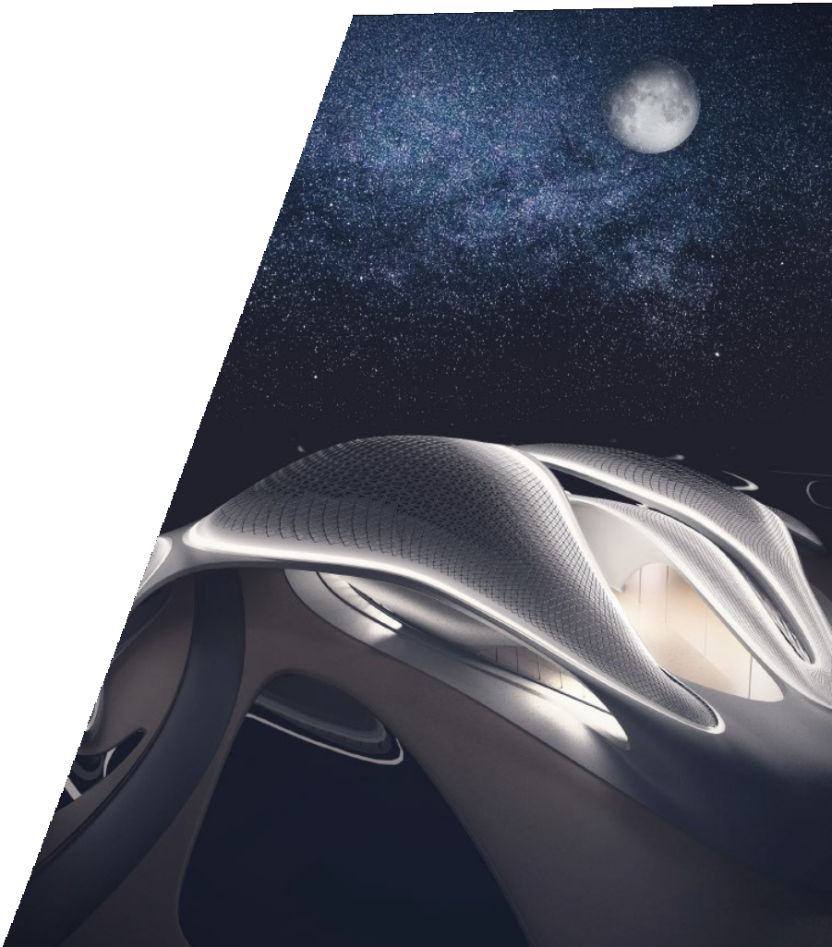
BEEAH GROUP Purpose:
More than a decade after the company’s inception, BEEAH Group’s offerings and borders have grown; but its purpose remains the same. BEEAH Group is committed to reimagining a sustainable future, and pushing its limits with the help of
technology.
Through innovation, full-circle resource management, and smarter solutions, the Group is addressing environmental challenges, deploying the latest digital technologies, and raising quality of life for people across the MENA region.

Slide 12

BEEAH GROUP includes 7 categories
BEEAH TRANSPORT
BEEAH EDUCATION
ENERGY
BEEAH RECYCLING
BEEAH ENVIRONMENTAL SERVICES
BEEAH TANDEEF
BEEAH DIGITAL

Slide 13
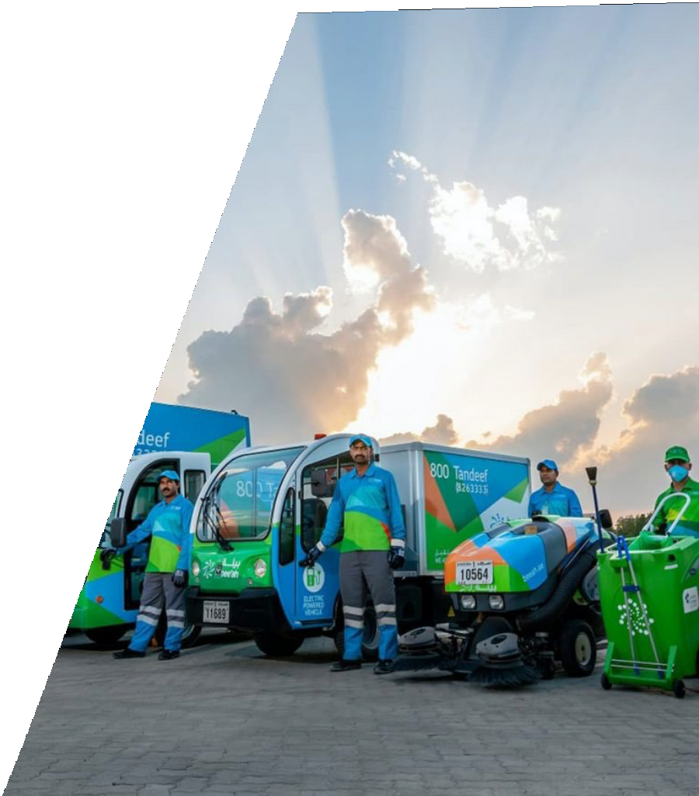
BEEAH TANDEEF
BEEAH Tandeef uses the latest industry technologies and best-in-class practices to provide street cleaning, waste collection, waste tracking and waste sorting services.
The company was also the ﬁrst in the region to introduce solar-powered smart bins, which use energy to compact waste, and act as community Wi-Fi hotspots. BEEAH Tandeef conducts its operations using a smart,
eco-friendly ﬂeet, which includes the likes of automated sweepers, electric street cleaners, electric desert cleaners and other state-of-the-art vehicles.
This smart ﬂeet will soon include Tesla’s revolutionary electric Semi trucks.
Categories

Slide 14
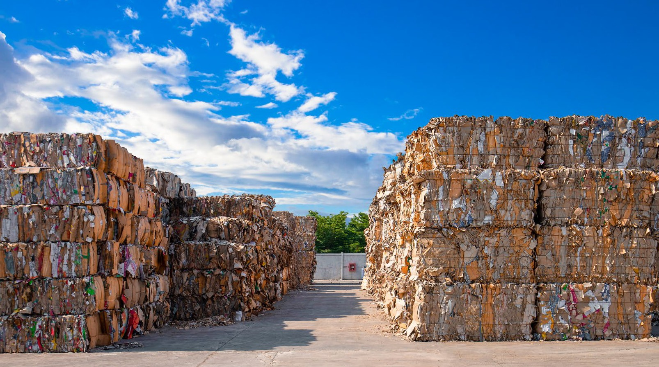

BEEAH RECYCLING
Through the BEEAH Recycling vertical, BEEAH Group has developed a self-sustaining model for the management of waste and zero-waste strategies
BEEAH Recycling’s solution to deriving value from waste starts with a state-of-the-art Waste Management Centre.
Through a carefully planned phasing strategy, the company has built some of the world’s most advanced recycling facilities at this Centre.
These facilities maximize recovery and waste diversion, while driving the zero-waste agenda set by BEEAH Group. At these facilities, waste is sorted, processed, treated and regenerated in forms that further beneﬁt the economy. Categories

Slide 15


BEEAH EDUCATION
BEEAH Education is an environmental education and awarding organisation for businesses and individuals contributing to a sustainable future. It aims to inculcate, incentivise and encourage sustainable action, from the grassroots level among schools and communities to professionals and organizations.
ACADEMY OF SUSTAINABILATY
The Academy of Sustainability engages thousands of students and teachers across more than 700 schools in the UAE. Through interactive games, environmental course modules, contests, and corporate awareness sessions, the Academy of Sustainability is pioneering environmental education, raising awareness and encouraging behavioral change for a sustainable future. Categories

Slide 16
BEEAH TRANSPORT
BEEAH Group strongly believes that low-carbon mobility solutions are the future of the transportation industry, and essential to achieving sustainable development.
Categories

Slide 17
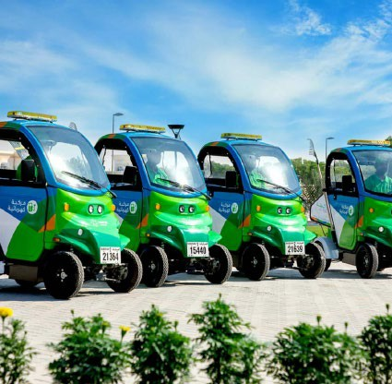
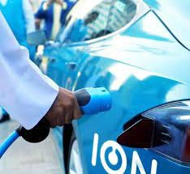
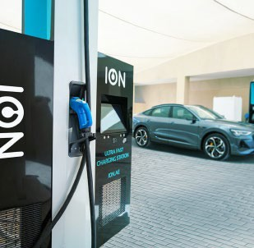
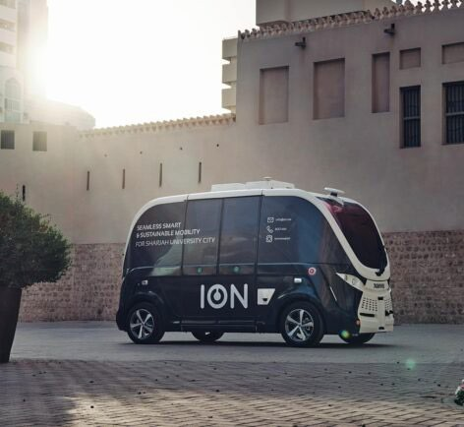
ION
To support the transition to green vehicles in the UAE, BEEAH Group partnered with Crescent Enterprises to establish the country’s ﬁrst exclusive sustainable mobility solutions provider, ION, in 2018.
ION aims to provide eco-friendly transportation that is safe, affordable and accessible to all. The company delivers end-to-end mobility solutions.
By creating a zero-emissions transport infrastructure in the MENA region, ION is supporting the region’s carbon neutrality goals and providing mobility solutions that beneﬁt the people and the planet.

Slide 18

BEEAH ENERGY
Recognizing the importance of renewable energy sources in building a sustainable future, BEEAH Group has invested in innovative and unique techniques to harness clean energy, through its vertical, BEEAH Energy.
In its search for alternative sources, BEEAH Energy identiﬁed waste-to-energy as an untapped energy source of great potential in the Middle East; as it resolves the region’s issue of waste accumulation while generating large amounts of renewable energy. Categories

Slide 19
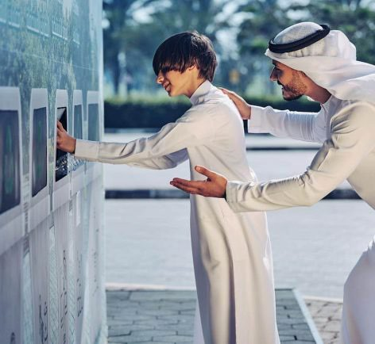
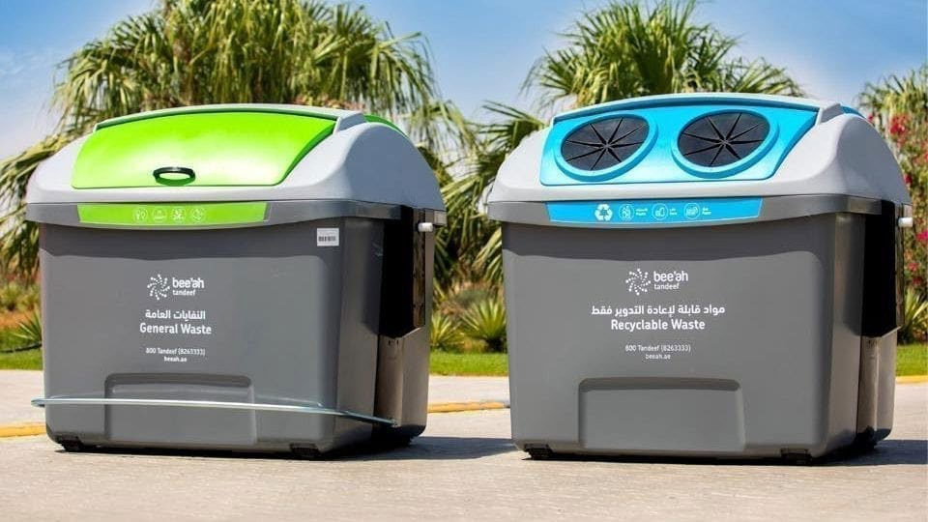
BEEAH Environment Services
BEEAH Environment Services enables public and private clients to make informed decisions considering environmental and ecological impact
BEEAH Environment Services provides sustainability consulting, air, soil and water quality studies, waste management research, ecological surveys, environmental and safety assessments, as well as site remediation studies. Categories

Slide 20

BEEAH DIGITAL
BEEAH Group has invested in digital ventures that push technology to its full potential, to build technologically empowered societies and create meaningful impact on people’s lives.
EVOTEQ
EVOTEQ, BEEAH Group’s digital company, was founded in 2017 with a mission to accelerate digital transformation in the Middle East. Through innovative digital solutions and platforms, EVOTEQ enables governments and large enterprises to improve performance, increase efﬁciency, become smarter, more responsive, and capable of making better informed decisions.
RE.LIFE
Launched by BEEAH Group in 2020, re.life is an innovative venture that enables a better life through a digital ecosystem, by using online platforms to empower decision-making in citizens and businesses. The company focuses on ensuring convenience, efﬁciency and transparency to improve quality of life.
Categories

Slide 21

Now, you know why The UAE is one of the cleanest countries in the world.
presented by:
Joe Mansour - Joe Zbeidy - Simon Kamel - Anthony Germanos - Fares Saab

